Slide 1
Marriage
Dress modestly
Learn the customs
Mehendi ceremony,
Enjoy the food
Hindu Wedding Photography

Slide 2
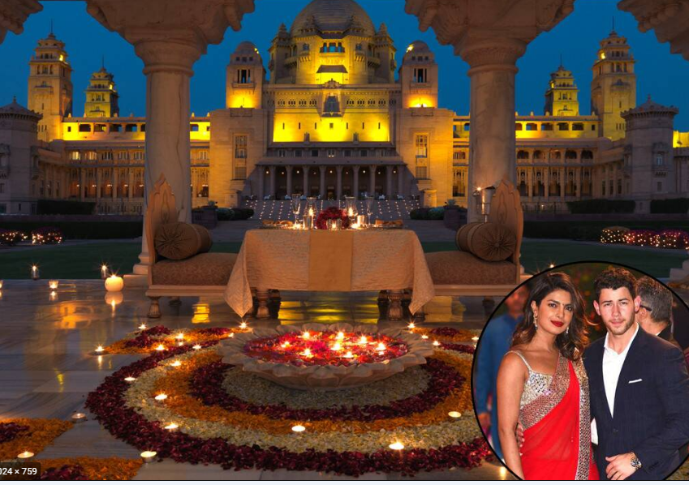

Slide 3
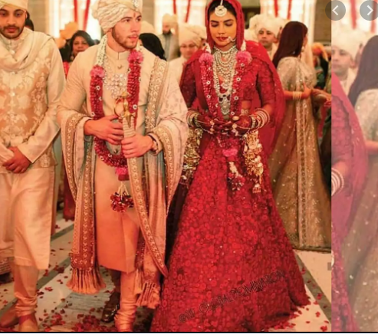
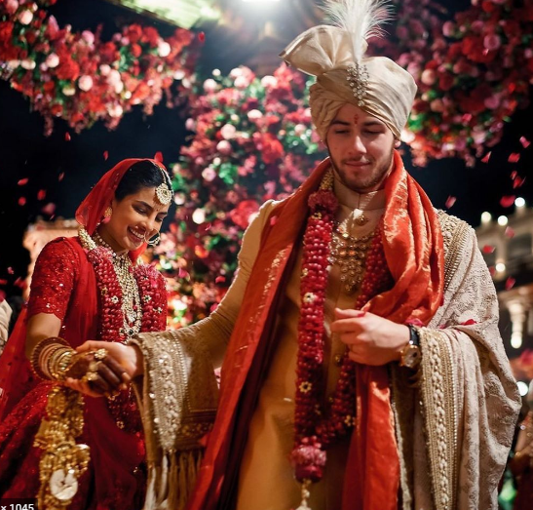

Slide 4
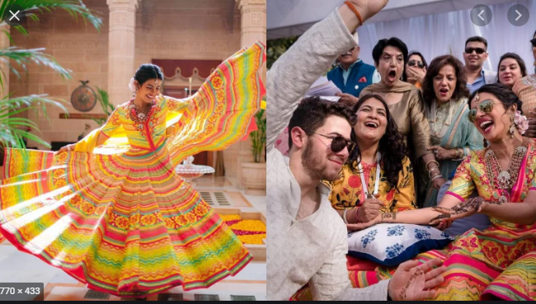
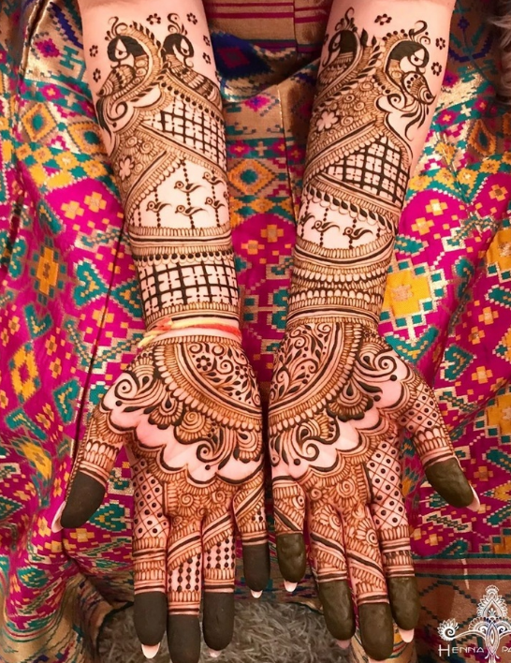
Mehendi ceremony,
Notes:
The party kicked off on Friday with the Mehendi ceremony, an Indian wedding ritual that typically happens one or two days before the weddingIn a typical Mehendi ceremony, all of the women in the bride and groom’s families, along with close friends, gather together while the bride has elaborate henna designs applied to her hands and feet. Guests will usually get a few designs on their hands as well.

Slide 5
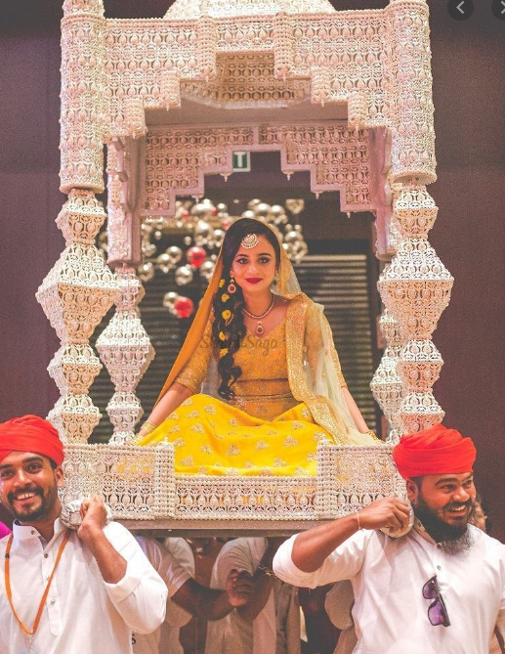
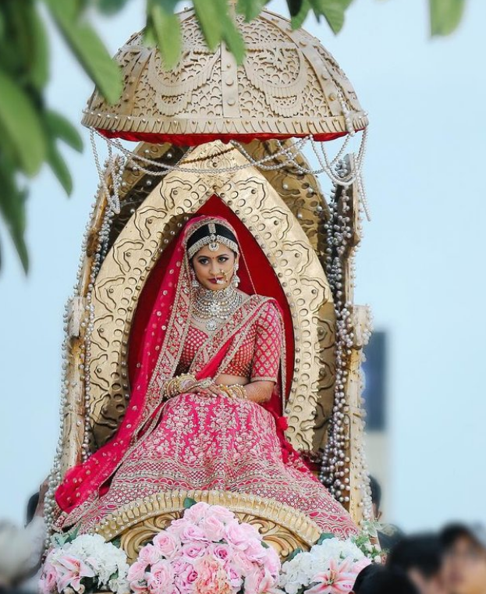
palki-bridal-entry
Notes:
The one thing that all brides-to-be share in common is their dream of looking like a mesmerising princess on their wedding day
A palki with a chariot like structure makes for a royal entry

Slide 6
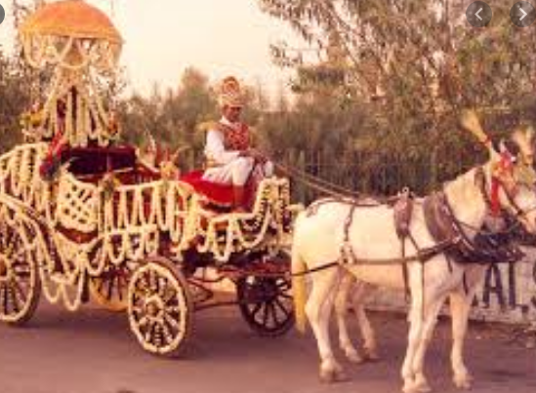
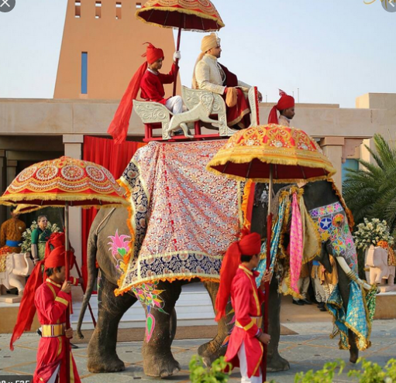
Groom

Slide 7
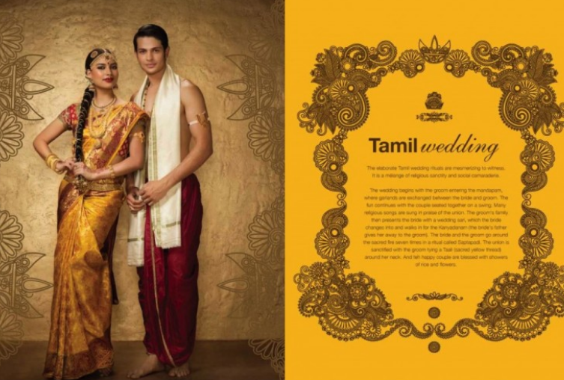
Tamil Wedding

Slide 8
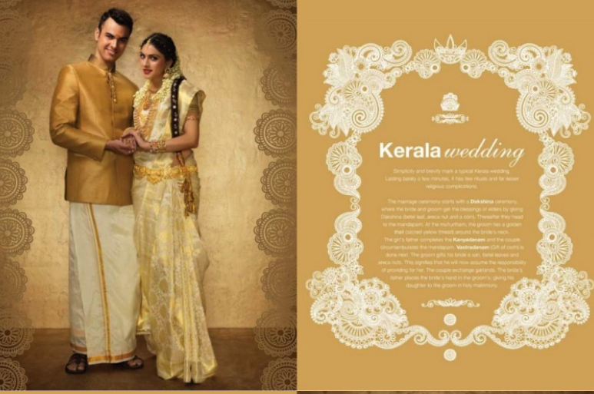
Kerala wedding

